Slide 1
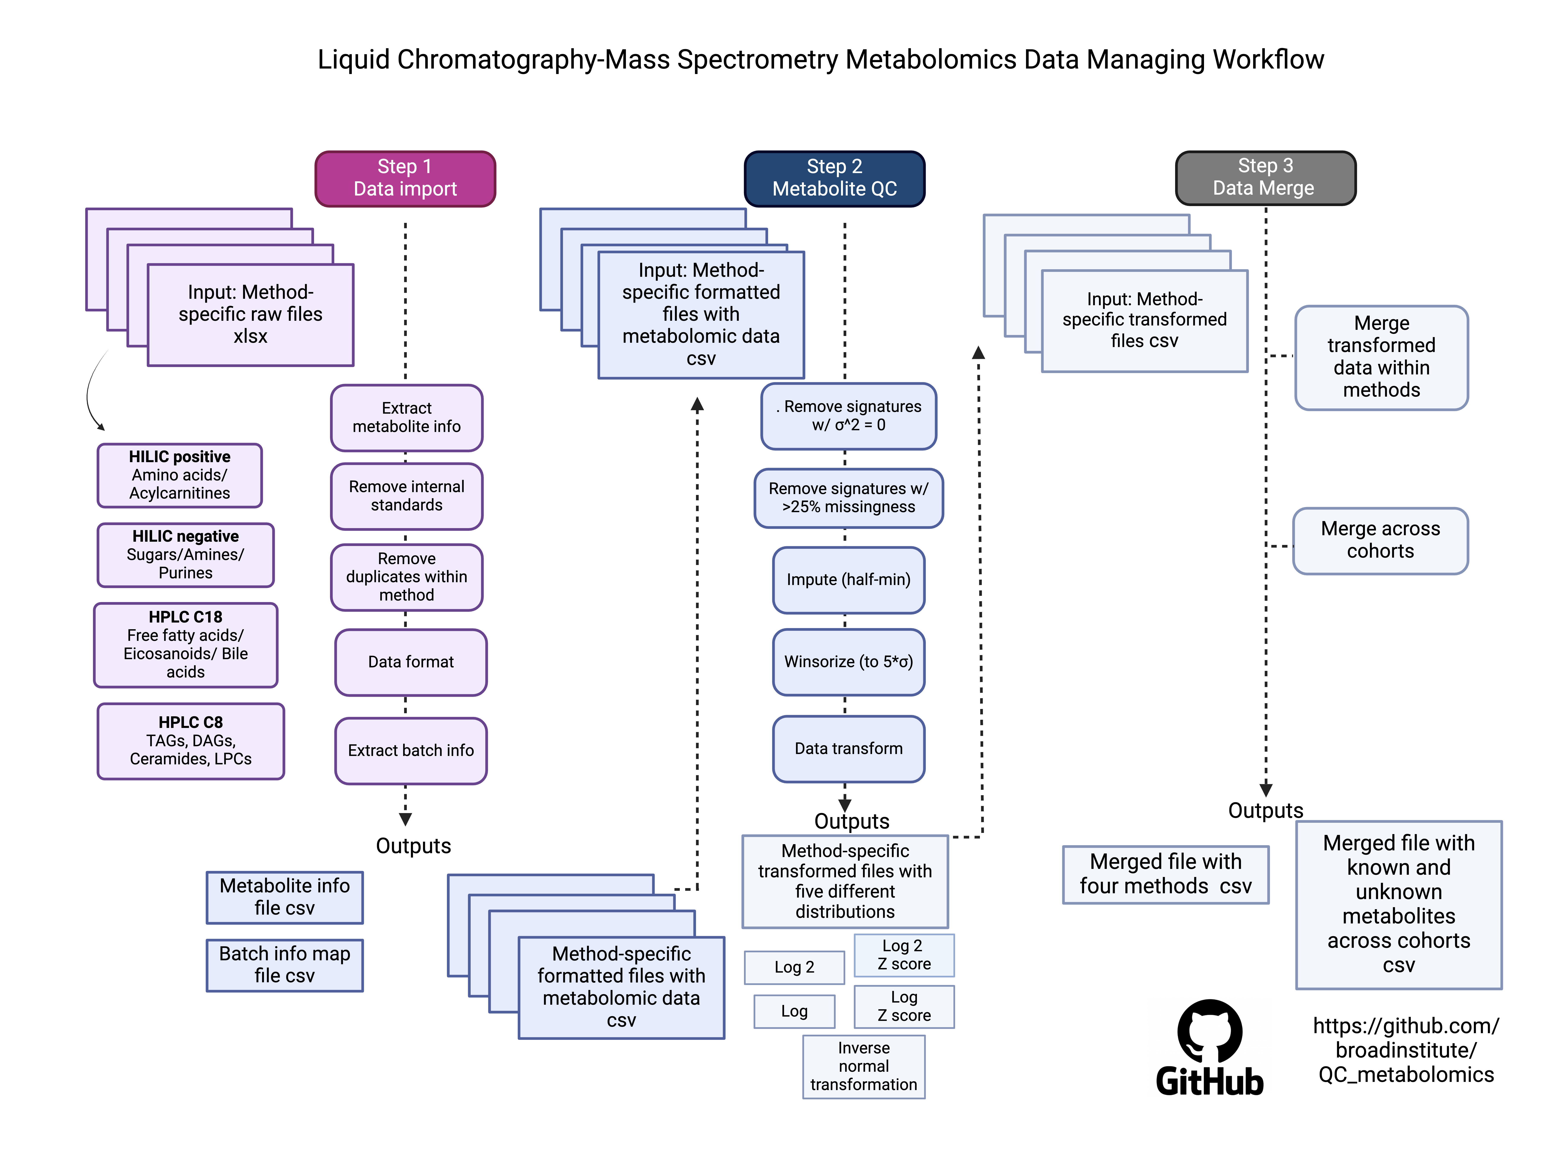
Supplementary Figure 1. Flowchart illustrating the data processing pipeline for LC-MS metabolomics dataset, incorporating comprehensive quality control measures that include removal of metabolites with zero variance, exclusion of metabolites and samples with over 25% missing values, imputation of remaining missing values with half of the minimum observed value, and Winsorization of outliers within ±5 standard deviations to mitigate extreme value effects. Data stabilization was achieved through various normalization techniques, including log, log2, and normal inverse transformations, each followed by Z-score transformation. Data from different analytical methods were merged to create a consolidated dataset.
Figure created with BioRender

Slide 2
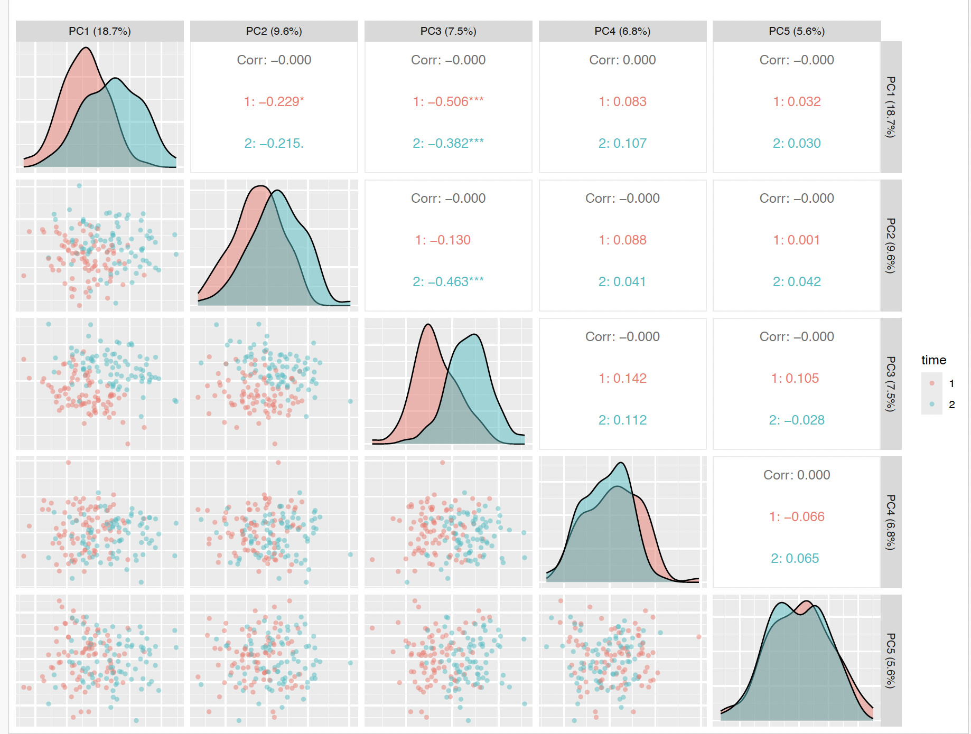
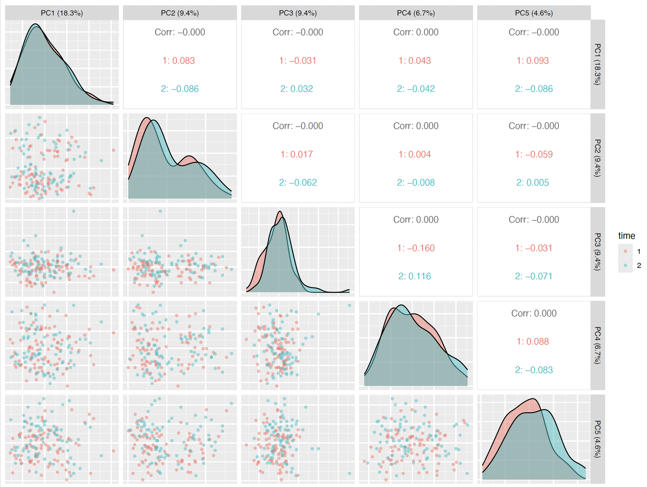
A
B
Fasting
Hyperinsulinemia
Supplementary Figure 2. Principal component analysis demonstrating metabolomic profile patterns in (A) plasma and (B) muscle during fasting and hyperinsulinemia. The plot shows Pearson correlations between the first five principal components and time points. Correlation coefficients between principal component pairs are presented in boxes, with values shown for overall correlation (Corr), fasting state (1), and hyperinsulinemic state (2). Statistical significance is indicated by asterisks: * p < 0.05, ** p < 0.01, *** p < 0.001.

Slide 3
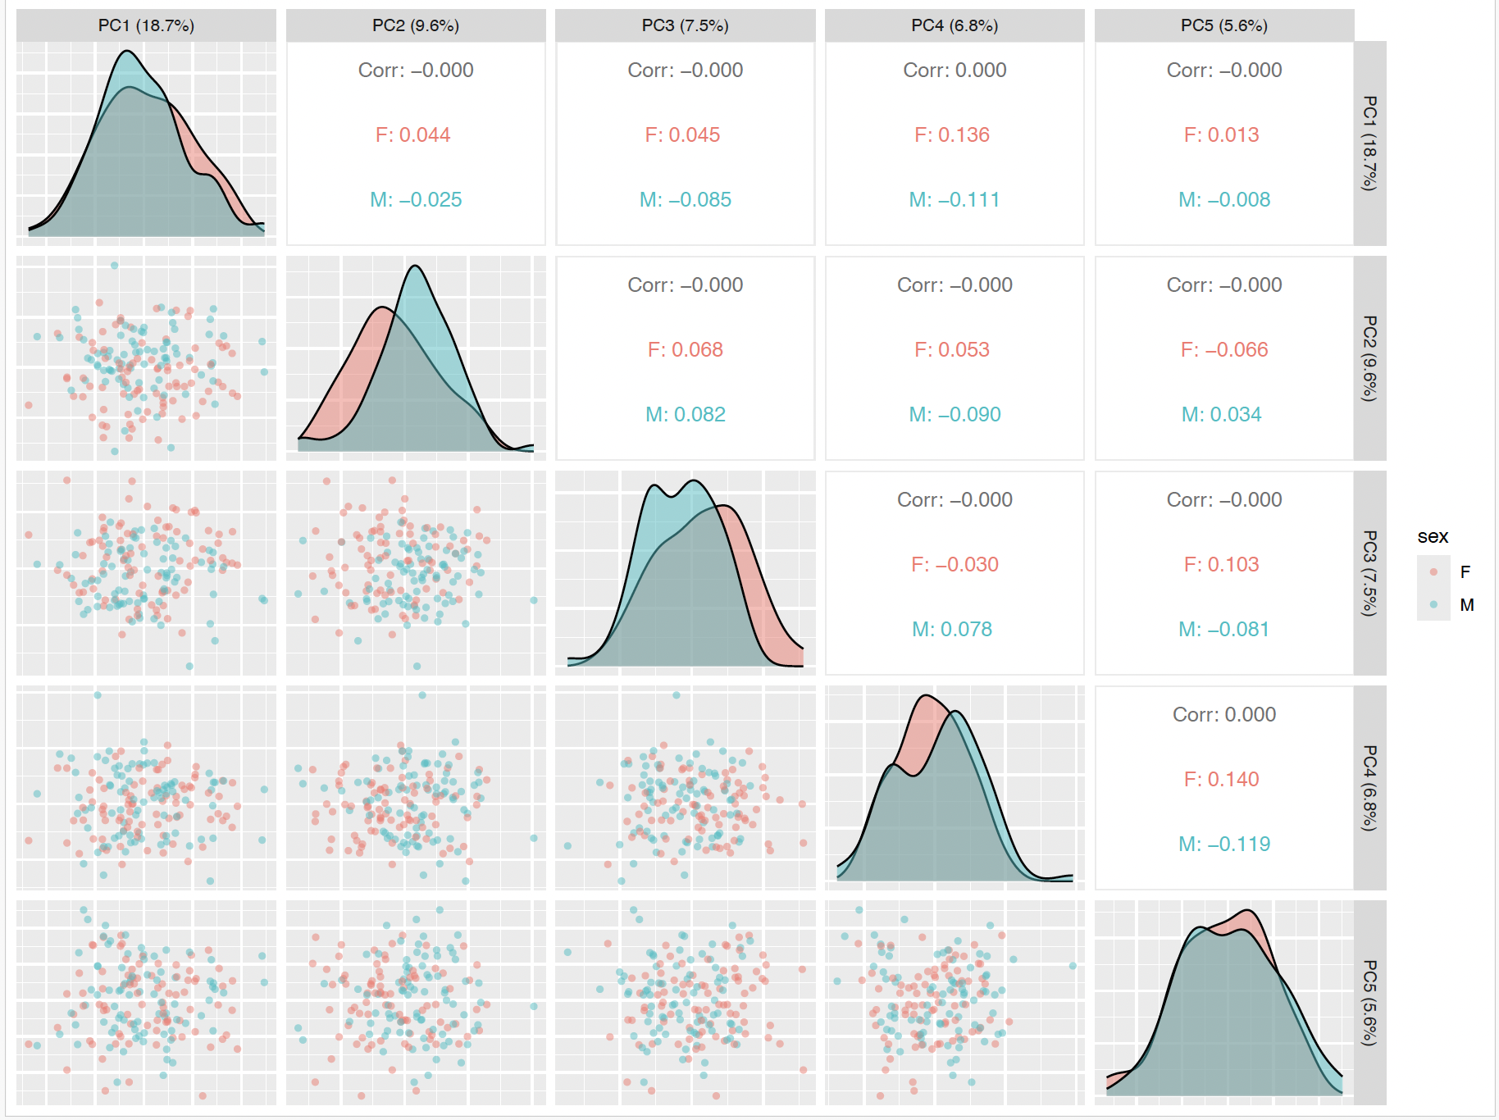
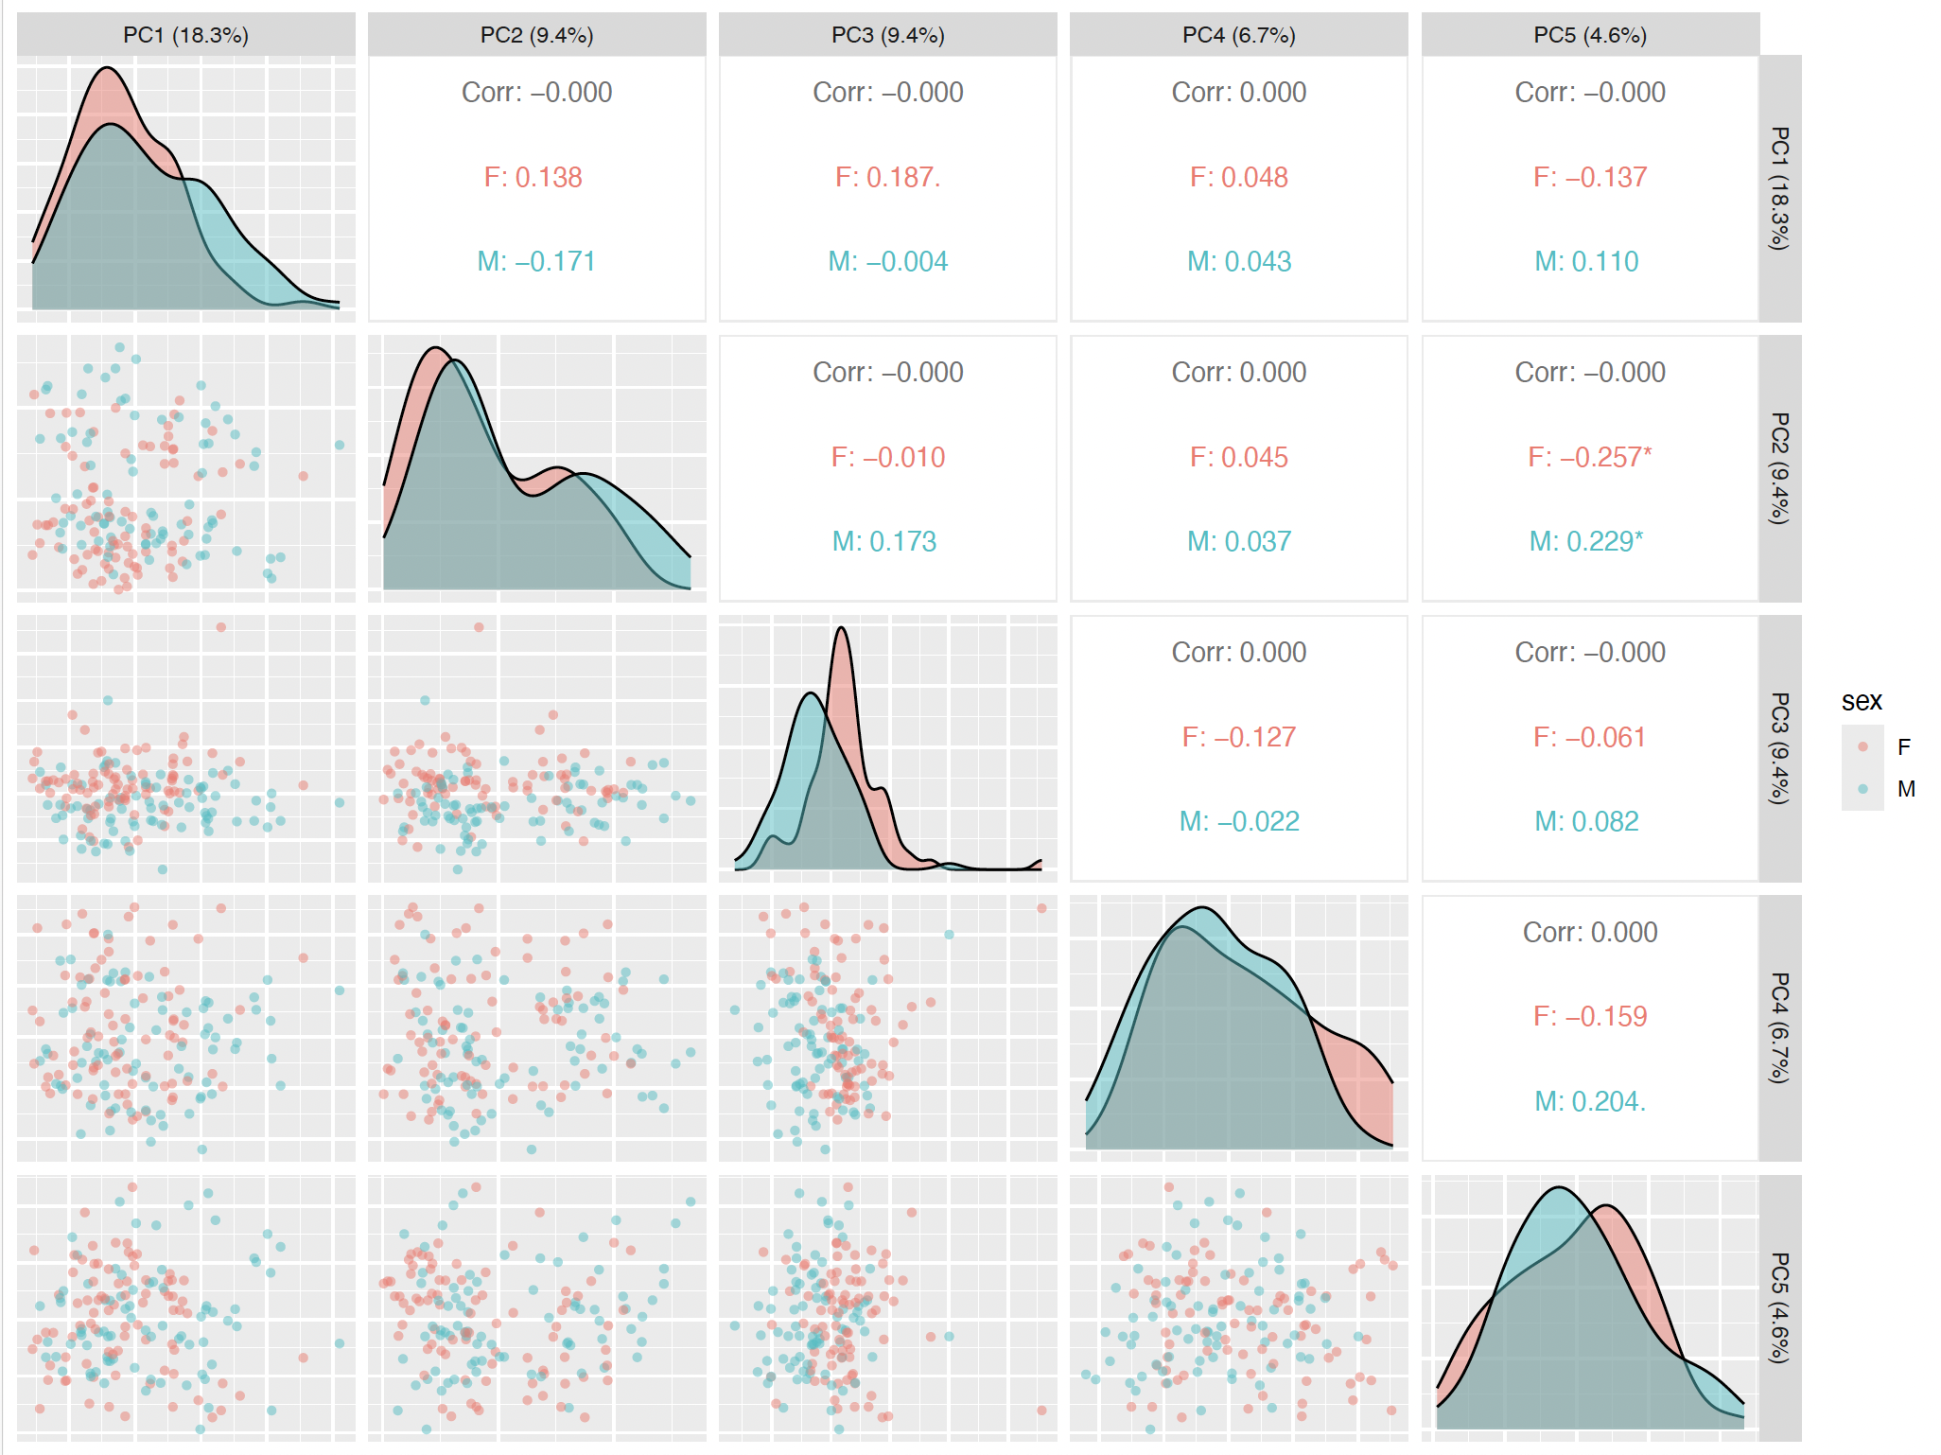
A
B
Supplementary Figure 3. Principal component analysis depicting sex-based differences in metabolomic profiles for (A) plasma and (B) muscle. The plot shows Pearson correlations between the first five principal components and biological sex. The correlation matrix displays Pearson coefficients between principal component pairs with values presented for overall correlation (Corr), females (F), and males (M). Statistical significance levels are denoted by asterisks: * p < 0.05, ** p < 0.01, *** p < 0.001.

Slide 4
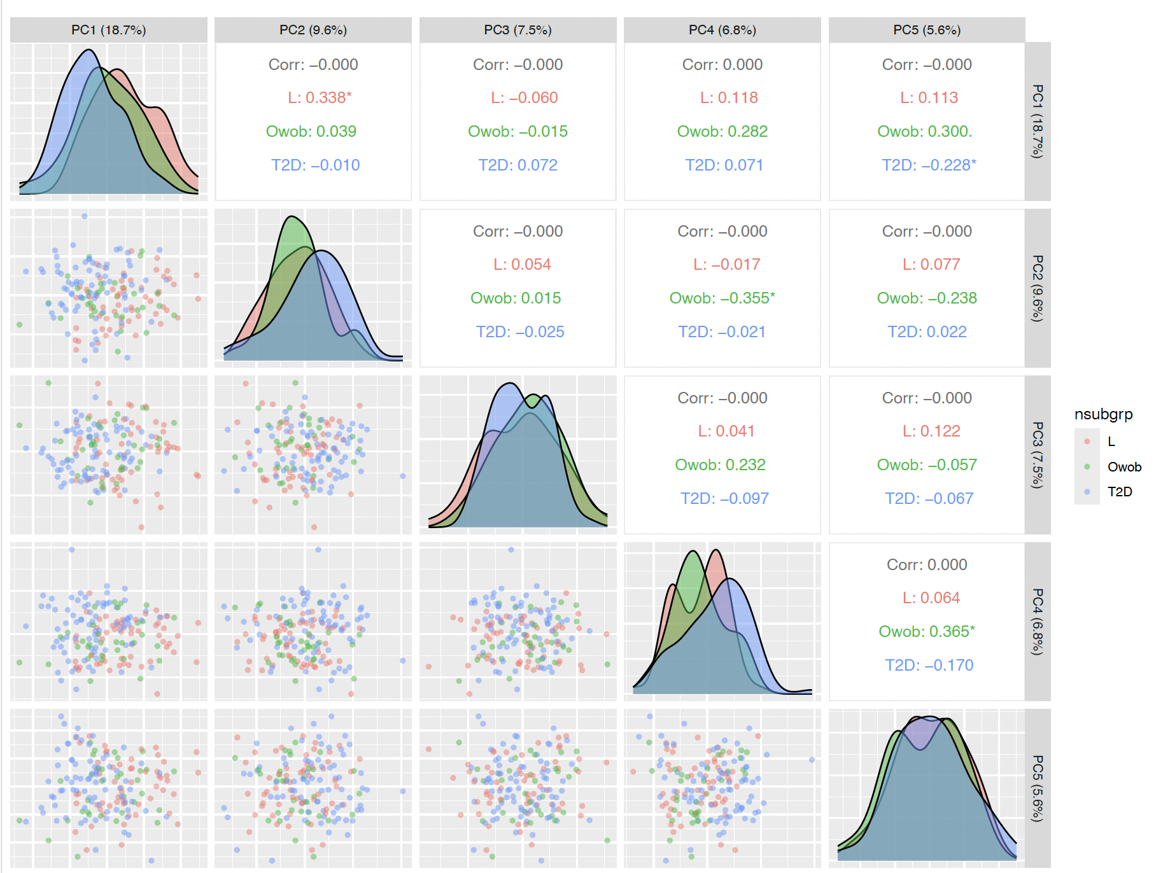
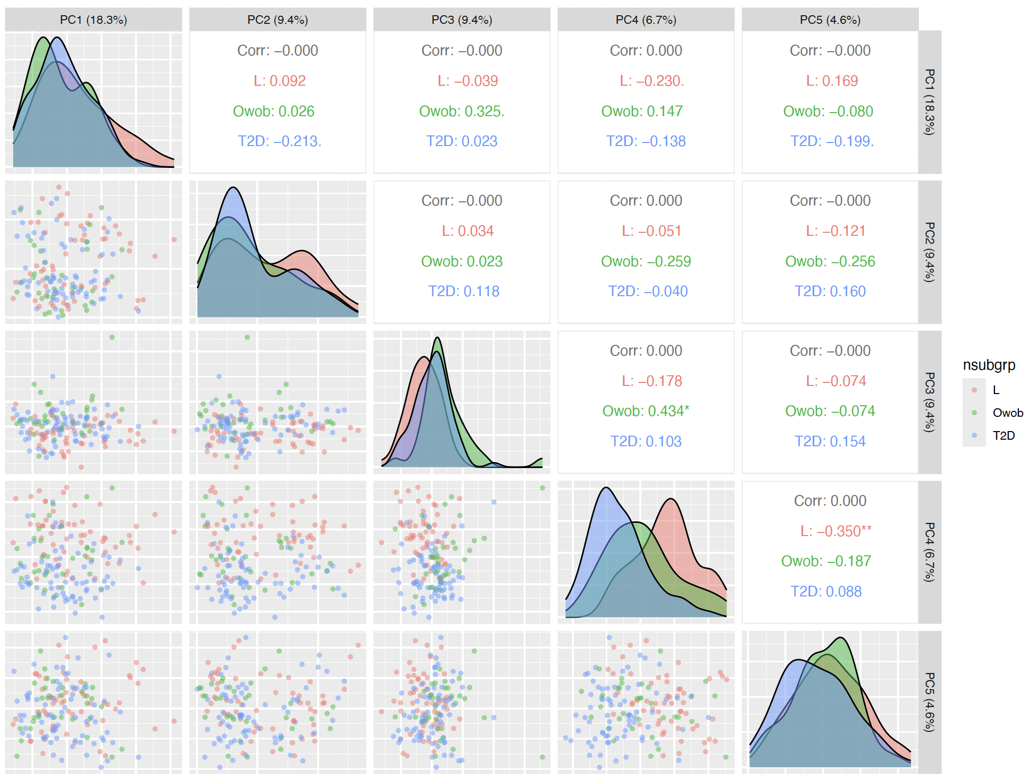
A
B
Supplementary Figure 4. Principal component analysis showing metabolomic profile patterns across different metabolic groups in (A) plasma and (B) muscle. The plot shows correlations between the first five principal components and metabolic status categories. Correlation matrices present Pearson coefficients between principal component pairs for overall correlation (Corr) and stratified by metabolic status (L, OvOb, T2D). Statistical significance is indicated by asterisks: * p < 0.05, ** p < 0.01, *** p < 0.001.

Slide 5
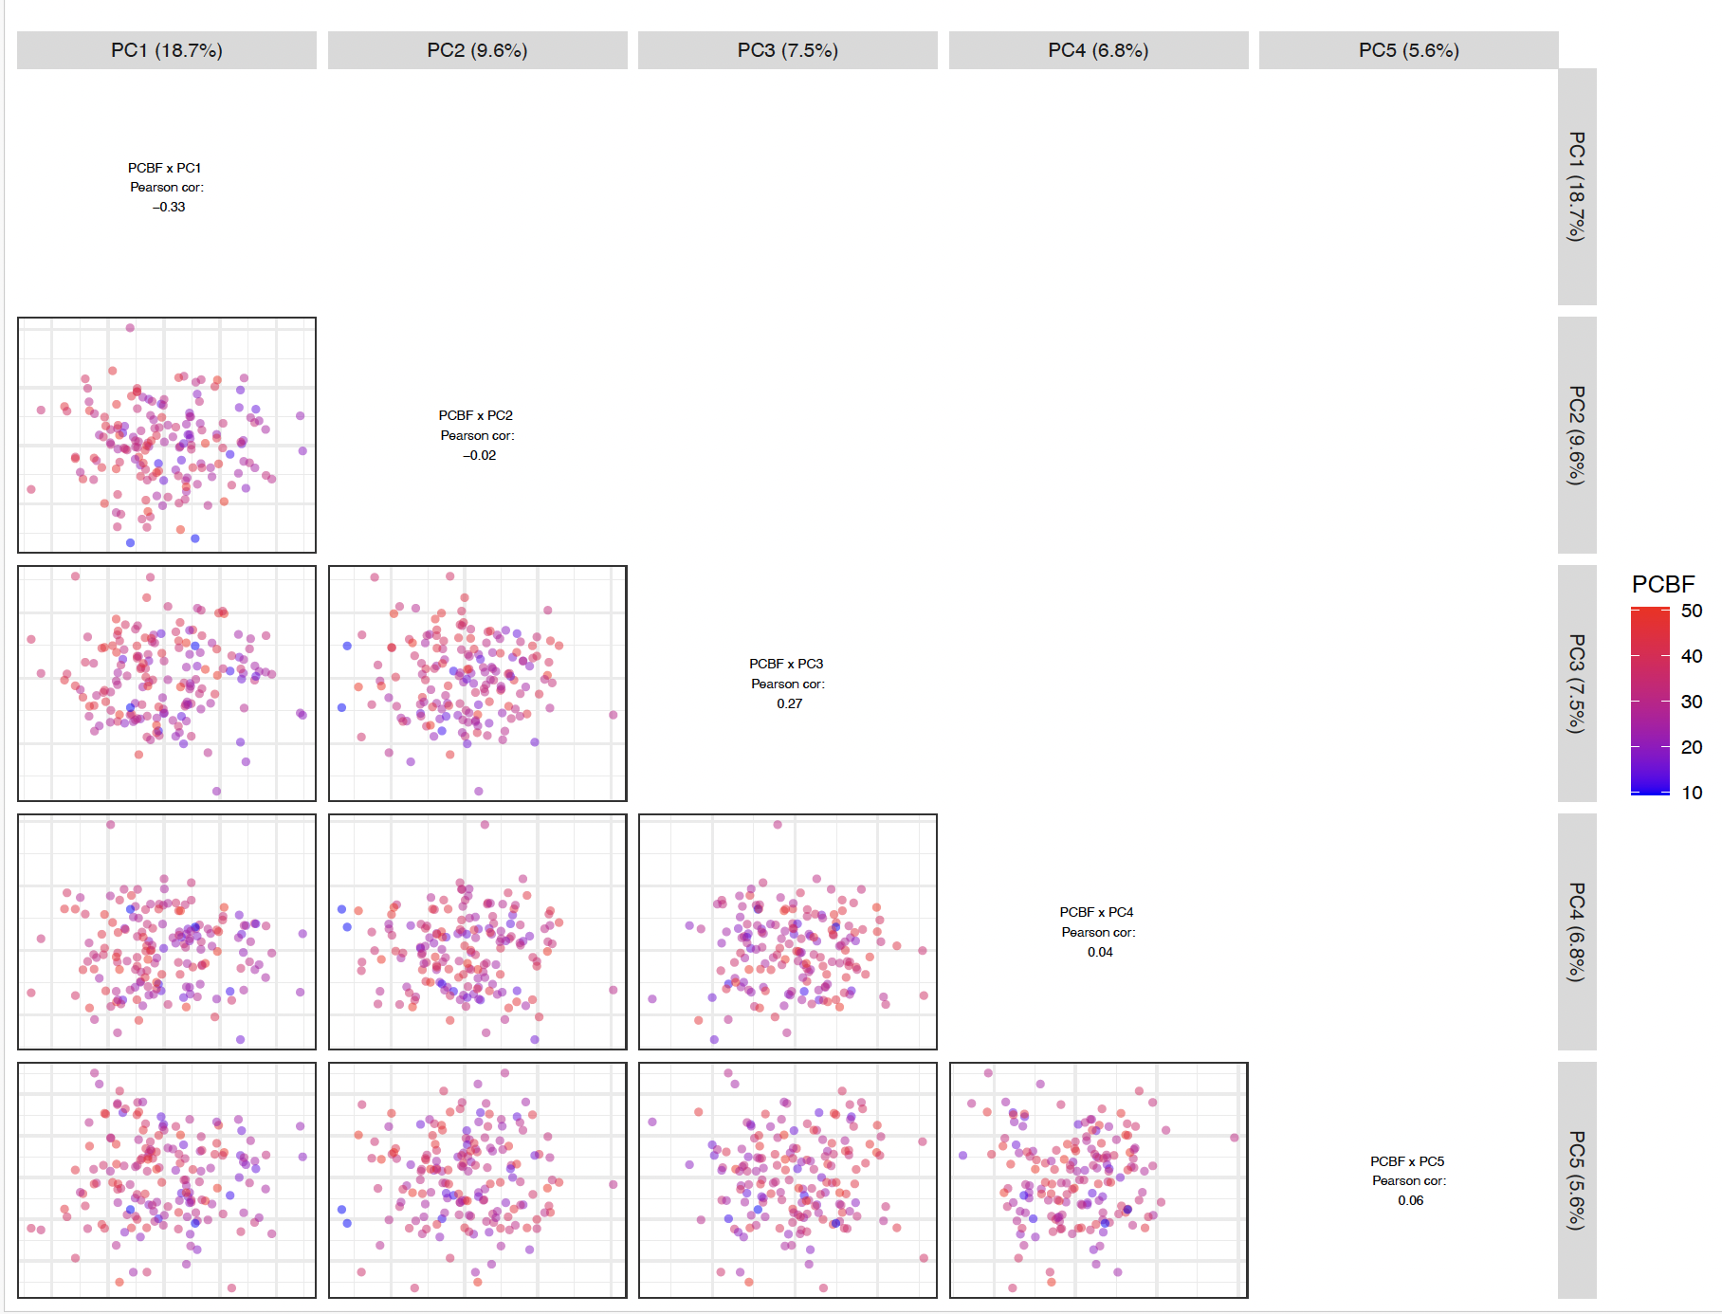
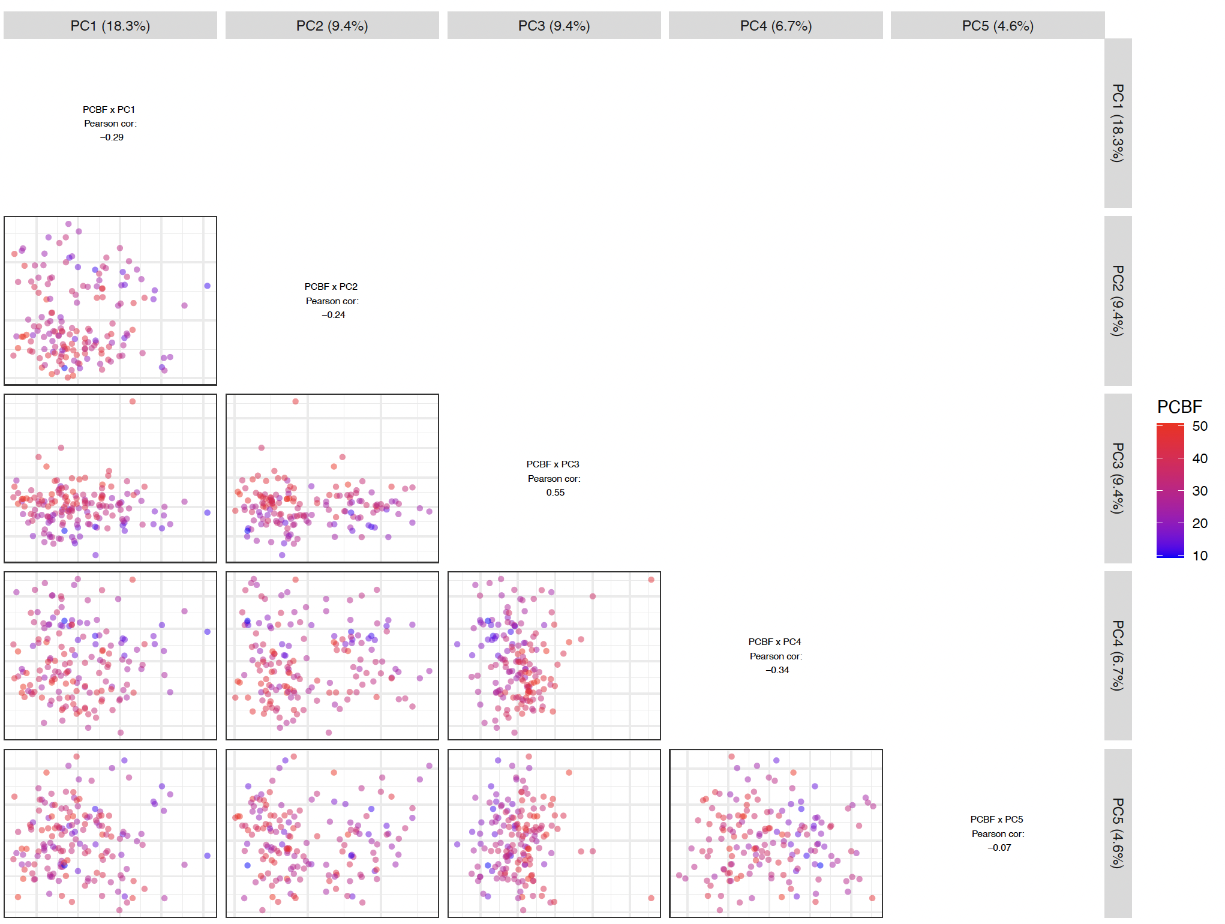
A
B
Supplementary Figure 5. Principal component analysis (PCA) displaying relationships between metabolomic profiles and percentage of body fat (PCBF) in (A) plasma and (B) muscle. The plot shows Pearson correlations between the first five principal components and PCBF.

Slide 6
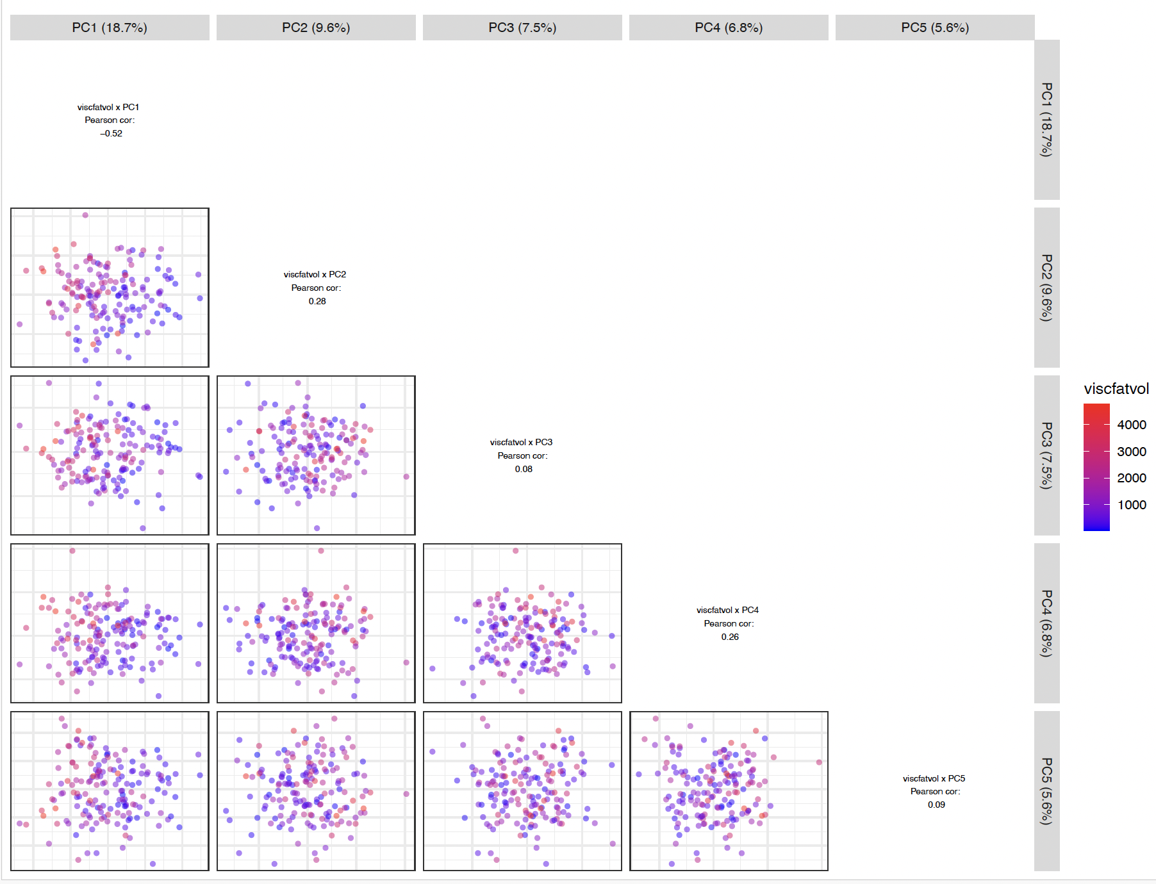
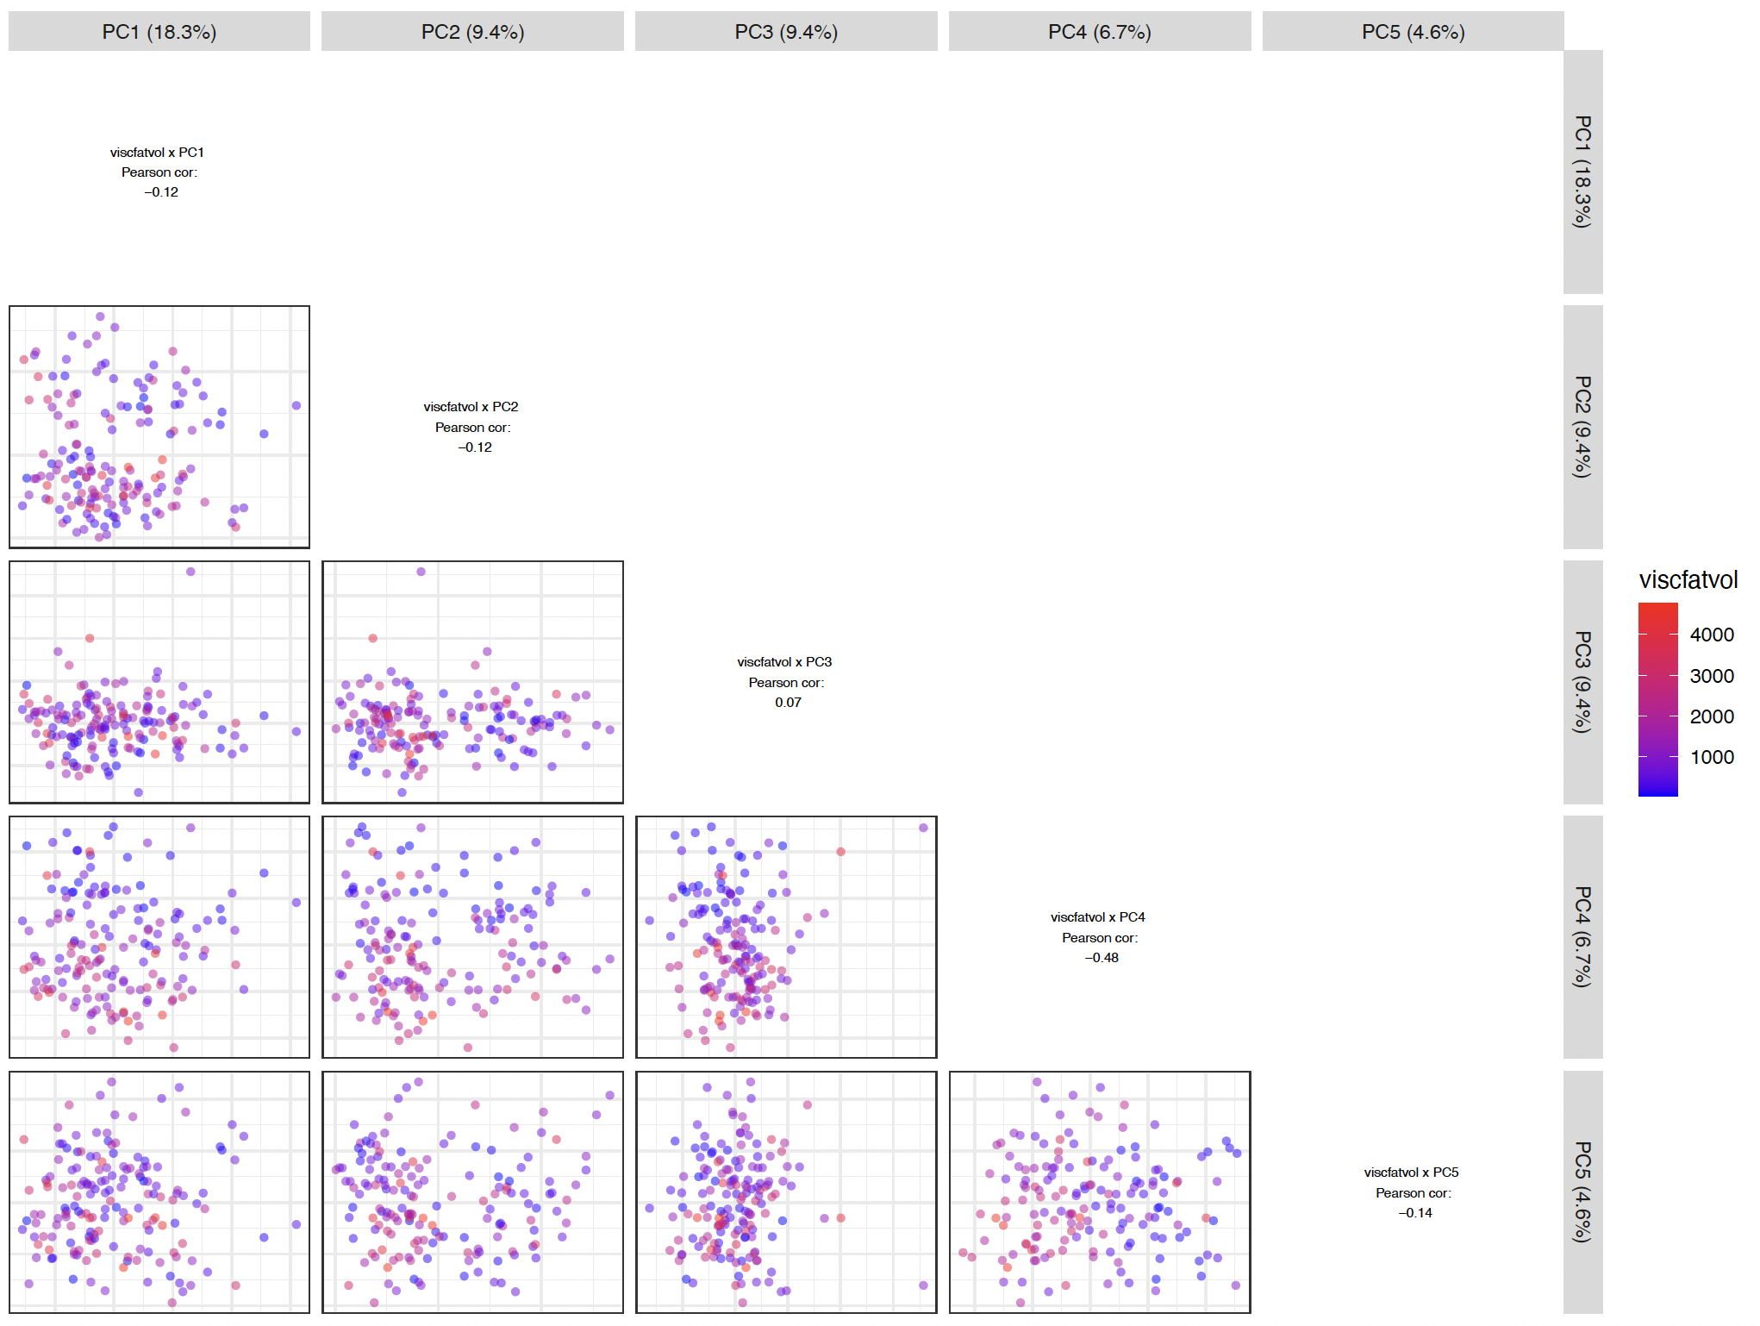
A
B
Supplementary Figure 6. Principal component analysis (PCA) illustrating associations between metabolomic profiles and visceral adiposity volume in (A) plasma and (B) muscle. The plot shows Pearson correlations between the first five principal components and visceral adiposity volume (viscfatvol).

Slide 7
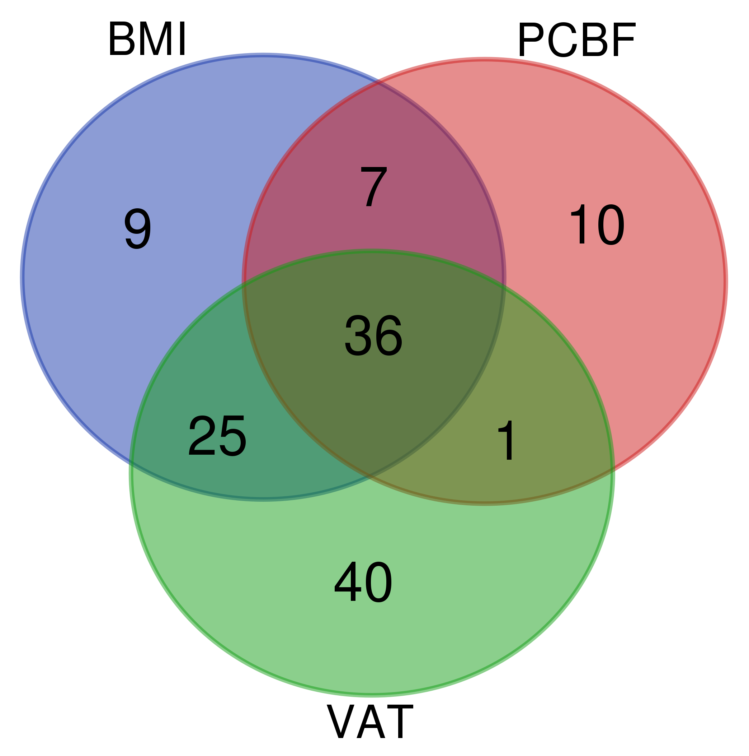
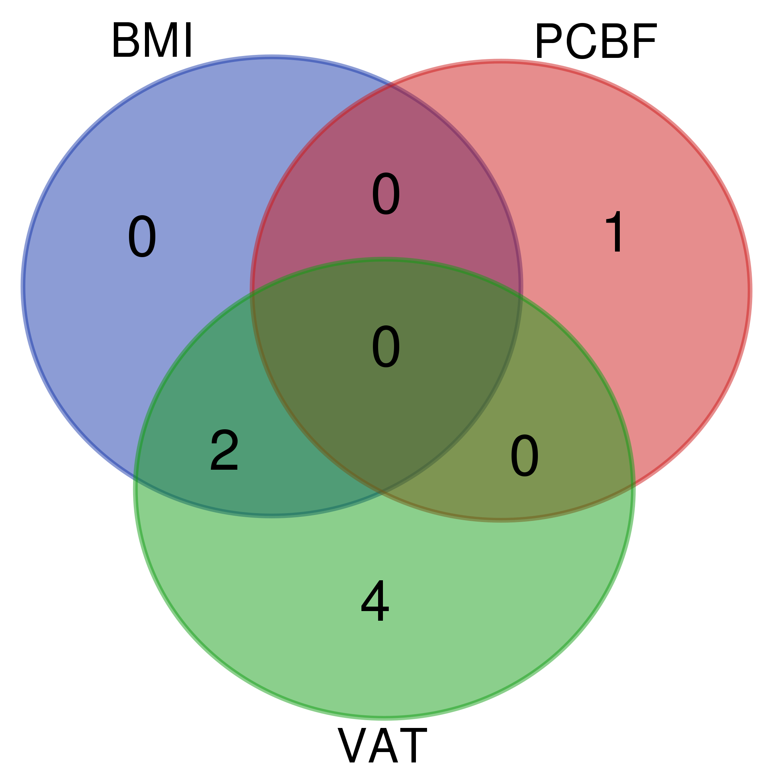
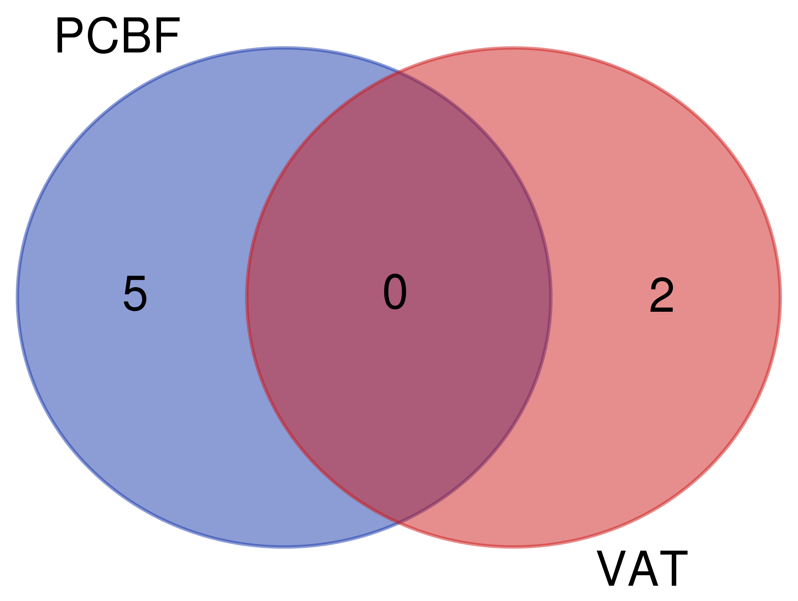
Positive
Interactions in Plasma
Negative
Supplementary Figure 7.
Supplementary Figure 7. Venn diagrams showing significant metabolites in plasma and muscle that interact with different body composition traits during hyperinsulinemia. The diagrams summarize significant associations identified using linear mixed models adjusted for age, age², and sex, with p-values corrected for multiple comparisons. (A) Positive interactions in plasma, where higher body composition traits associate with greater metabolite changes during hyperinsulinemia. (B) Negative interactions in plasma. (C) Interactions in muscle, where all interactions with PCBF were negative, while interactions with VAT were positive. Abbreviations: BMI, body mass index; VAT, visceral adipose tissue; PCBF, percentage of body fat; TGs, triglycerides; LPEs, lysophosphatidylethanolamines; PEs, phosphatidylethanolamines.
A
B
TG(50:0) TG(56:1) TG(56:2) TG(55:2) TG(56:4) TG(54:6) TG(56:7) TG(58:7) PE(36:1) DG(32:0)
Citrate/isocitrate
TG(54:5)
TG(52:6)
TG(54:7)
TG(51:0)
TG(52:5)
LPC(20:4)
NMMA
lysine
salicylurate
TAGs: TG(46:4), TG(47:2)
LPEs: LPE(18:3), LPE(20:4), LPE(22:6)
PEs: PE(36:4), PE(36:2), PE(34:2), PE(36:3)
Sphingolipids: SM(d18:1/14:0), Cer(d18:1/24:1)
Carnitines: Multiple carnitines, including C2, C4-OH, and long-chain variants.
Fatty Acids: Saturated, monounsaturated, and polyunsaturated fatty acids.
Hydroxylated and Specialized Fatty Acids: 2-Hydroxyhexadecanoate, 12,13-diHOME.
Amino Acids and Derivatives:
2-Aminoisobutyric acid, 2-Aminoheptanoate, Homoarginine.
Malate Inositol Fructose/glucose/galactose Fumarate/maleate
Interactions in Muscle
Myristate
Alpha-hydroxystearate
Heptadecanoate
PE(P-36:1)/PE(O-36:2)
LPE(18:2)
Glutamate
Levulinate

